Slide 1
Planning Business Messages

Slide 2

Effective Business Messages
Purposeful
Audience-Centered
Concise
Notes:
Some of your tasks will be routine, needing little more than jotting down a few sentences; others will be more complex, requiring reflection, research, and careful document preparation. Whatever the situation, your messages will be more effective if they have the following characteristics:
Purposeful. Business messages provide information, solve a problem, or request the resources necessary to accomplish a goal. Every message has a specific purpose.
Audience-centered. Business messages help audiences understand issues, collaborate on tasks, or take action. Each message considers the audience’s needs, background, and viewpoint.
Concise. Business messages respect everyone’s time by presenting information clearly and efficiently. Every message should be as short as it can be without detracting from the subject.

Slide 3
Three-Step Writing Process
1
Planning
2
Writing
3
Completing
Analyze the
Situation
Organize the
Message
Revise the Message
Investigate the
Topic
Compose the Message
Produce the Message
Adapt to the
Audience
Proofread the
Message
Notes:
The specific actions you take to write business messages will vary with each situation, audience, and purpose. However, following a three-step writing process will help you write more effective messages.
Planning. Clarify your purpose and gather information to inform, persuade, or motivate your audience. Select the channel and medium that suit both your needs and those of your audience. Establish a good relationship with your audience. Planning business messages is the focus of this chapter.
Writing. Organize your ideas and commit your thoughts to words, write sentences and paragraphs, and select illustrations and details to support your main idea. Writing business messages is discussed in Chapter 4.
Completing. Review the content and organization for overall style, structure, and readability. Revise and rewrite until your message is clear; then edit for details such as grammar, punctuation, and format. Next produce your message, putting it into the form that your audience will receive. Finally, proof the final draft for typos, spelling errors, and other mechanical problems. Completing business messages is discussed in Chapter 5.
As a general rule, try using roughly half of your time for planning. Use less than a quarter of your time for writing your document. Then use more than a quarter of your time for completing the project (so that you don’t shortchange important final steps such as revising and proofing).

Slide 4

Analyze Your Purpose
Timing
General
Purpose
Specific
Purpose
Delivery
Realism
Acceptability
Notes:
When planning a business message, the first thing you need to think about is your purpose. For a business message to be effective, its purpose and its audience must complement each other.
All business messages have a general purpose: to inform, to persuade, or to collaborate with your audience. Business messages also have a specific purpose. To help you define the specific purpose of your message, ask yourself what you hope to accomplish with your message and what your audience should do or think after receiving your message. Before proceeding, consider whether your purpose is worth pursuing at this time. Ask yourself these questions:
Is my purpose realistic?
Is this the right time?
Is the right person delivering this message?
Is my purpose acceptable to the organization?
Once you are satisfied that you have a legitimate purpose in communicating, take a good look at your intended audience.

Slide 5
Develop an Audience Profile
Identify primary audience
Determine size
Determine composition
Gauge level of understanding
Project expectations and preferences
Estimate probable reaction
Notes:
To satisfy your audience’s information needs, begin by identifying your primary audience. If you can reach the decision makers or opinion molders in your audience, other audience members will fall into place.
Remember to determine the size of your audience.
Define your audience’s composition. Look for common interests that link audience members across differences in culture, education, status, or attitude.
It’s important to gauge your audience’s level of understanding. If audience members share your general background, they’ll understand your material without difficulty. If not, you must educate them.
Do your best to project your audience’s expectations and preferences. Will members of your audience expect complete details, or will a summary of the main points suffice?
Remember to estimate your audience’s probable reaction. If you expect a favorable response, you can state conclusions and recommendations up front and offer minimal supporting evidence. If you expect skepticism, you can introduce conclusions gradually, with more proof.

Slide 6
Gather Information
Formal
Sources
Opinions
of Others
Employees
or Customers
Interviews
Company
Files
Audience
Input
Notes:
When writing long, formal reports, you’ll conduct formal research to locate and analyze all the information relevant to your purpose and your audience. Other kinds of business messages require less formal information gathering. For example, you may simply try to consider others’ viewpoints.
Or your company’s files may be a good source of the information you need for a particular memo or e-mail message. Consider company annual reports, financial statements, news releases, memos, marketing reports, and customer surveys for helpful information.
Chatting with supervisors, colleagues, or customers can help you gather information. Conducting telephone or personal interviews is a convenient way to gather information. And don’t forget to get audience input through casual conversation (face-to-face or over the phone), informal surveys, or unofficial interviews.

Slide 7

Provide Information
Complete
Accurate
Pertinent
Ethical
Notes:
Be careful when deciding what information to include in your messages. Make sure your information has the following characteristics:
Complete. Test the thoroughness of your message with the journalistic approach. Check to see whether your message answers who, what, when, where, why, and how.
Accurate. Your organization is legally bound by any promises you make, so be sure your company can follow through. Check with the appropriate people before you make the commitment. Also, review all calculations, check all dates and schedules, and examine your own assumptions and conclusions.
Ethical. Messages can be unethical simply because information is omitted. You need to include enough detail to avoid misleading your audience. Include as much information as you believe best fits your definition of complete, and then offer to provide more upon request.
Pertinent. Select the points that affect your audience the most. For an unknown audience, use common sense to identify points of particular interest. Factors such as job, location, income, or education can give you a clue.

Slide 8

Business Communication
Channels and Media
Oral Channel
Written Channel
Face-to-Face
Telephone
Meetings
Voice Mail
Videotape
Teleconferencing
Memos
Letters
Reports
E-mail
Websites
Instant Messages
Notes:
Before actually beginning to write your message, you need to figure out how to make it serve both your audience and your purpose. To adapt your message, you need to select a channel and a medium that fit your purpose and satisfy your audience’s expectations. In addition, you need to establish a good relationship with your audience.
You must choose between the oral or written channel, and you must consider all the media within each one. The oral channel includes media such as face-to-face conversation, telephone calls, speeches, presentations, and meetings. The chief advantage of oral communication is the opportunity it provides for immediate feedback. Your choice between a face-to-face conversation and a telephone call would depend on audience location, message importance, and your need for nonverbal feedback.
The written channel includes media that range from the scribbled notes people use to jog their own memories to formal reports. The most common written media are letters, memos, and reports. Written messages have a big advantage: They let you plan and control the message.
In addition to the traditional forms of oral and written media, both channels have electronic forms. Oral media also include voice mail, audiotape and videotape, teleconferencing and videoconferencing, closed-circuit television, and more. Written media also include e-mail, faxing, computer conferencing, websites, instant messaging, and more.

Slide 9
Selecting the Best Channel and Medium
Style and tone
Feedback
Time
Cost
Audience
Notes:
To choose the channel and medium that will best match your purpose and audience, consider the following elements:
Message style and tone. To emphasize the formality of your message, use a more formal medium, such as a memo or a letter.
Possibility for feedback. Various media offer various levels of feedback. The more feedback possible, the richer the medium.
Audience perception. To emphasize the confidentiality of a message, send a letter rather than a memo, or plan a private conversation rather than a meeting. To instill an emotional commitment, consider videotape or a videoconference, unless you require immediate feedback; then, face-to-face is best.
Time. If your message is urgent, you’ll probably use the phone, send a fax, or send your message by next-day mail.
Cost. You wouldn’t think twice about telephoning an important customer overseas if you just discovered your company had sent the wrong shipment. But you’d probably choose to fax or e-mail a routine order acknowledgment to an overseas customer.
Audience expectation. Consider which media your audience expects or prefers. You expect your college to deliver your diploma by hand at graduation or in the mail, not by fax.

Slide 10
Relating to the Audience
“You”
Attitude
Positive
Tone
Credibility
Polite
Treatment
Bias-Free
Language
Corporate
Image
Notes:
Once you’ve chosen an appropriate channel and medium, you’re still not ready to start writing. Effective communicators do more than simply convey information. They make sure that they establish a good relationship with their audience.
To give the right impression in your message, think carefully about who you are and who your audience is. Then do your best to be yourself. Since a good relationship is based on sincerity, respect, and courtesy, show yours by using the “you” attitude, emphasizing the positive, establishing your credibility, being polite, using bias-free language, and projecting the company’s image.

Slide 11
The “You” Attitude
Instead of This
Use This
To help us process this order, we must ask for another copy of the requisition.
So that your order can be filled promptly, please send another copy of the requisition.
Instead of This
Use This
You should never use that type of paper in the copy machine.
That type of paper doesn’t work very well in the copy machine.
Notes:
To project your audience-centered approach, adopt a “you” attitude––that is, speak and write in terms of your audience’s wishes, interests, hopes, and preferences. On the simplest level, replace terms that refer to yourself and your company with terms that refer to your audience. Use you and yours instead of I, me, mine, we, us, and ours (see the order processing example above).
However, using you and yours requires finesse. The important thing is your attitude toward audience members and your appreciation of their position.
In fact, on some occasions you’ll do better to avoid using you. For instance, using you in a way that sounds dictatorial is impolite. Or, when someone makes a mistake, you may want to minimize ill will by pointing out the error impersonally. You might say, “We have a problem,” instead of “You caused a problem” (see the copy machine example above).

Slide 12
Emphasize the Positive
Instead of This
Use This
It is impossible to repair your vacuum cleaner today.
Your vacuum cleaner will be ready by Tuesday.
Instead of This
Use This
Cheap merchandise
Toilet paper
Elderly person
Bargain prices
Bathroom tissue
Senior citizen

Slide 13
Establish Credibility
Show Your Understanding
Explain Your Credentials
Avoid Exaggerating
Believe in Yourself

Slide 14
Be Polite
Instead of This
Use This
You really fouled things up with that last computer run.
Let’s review what went wrong so that the next computer run goes smoothly.
Instead of This
Use This
You’ve been sitting on our order for two weeks. We need it now!
We are eager to receive our order. When can we expect delivery?

Slide 15
Use Bias-Free Language
Gender
Race or
Ethnicity
Age Bias
Disability

Slide 16
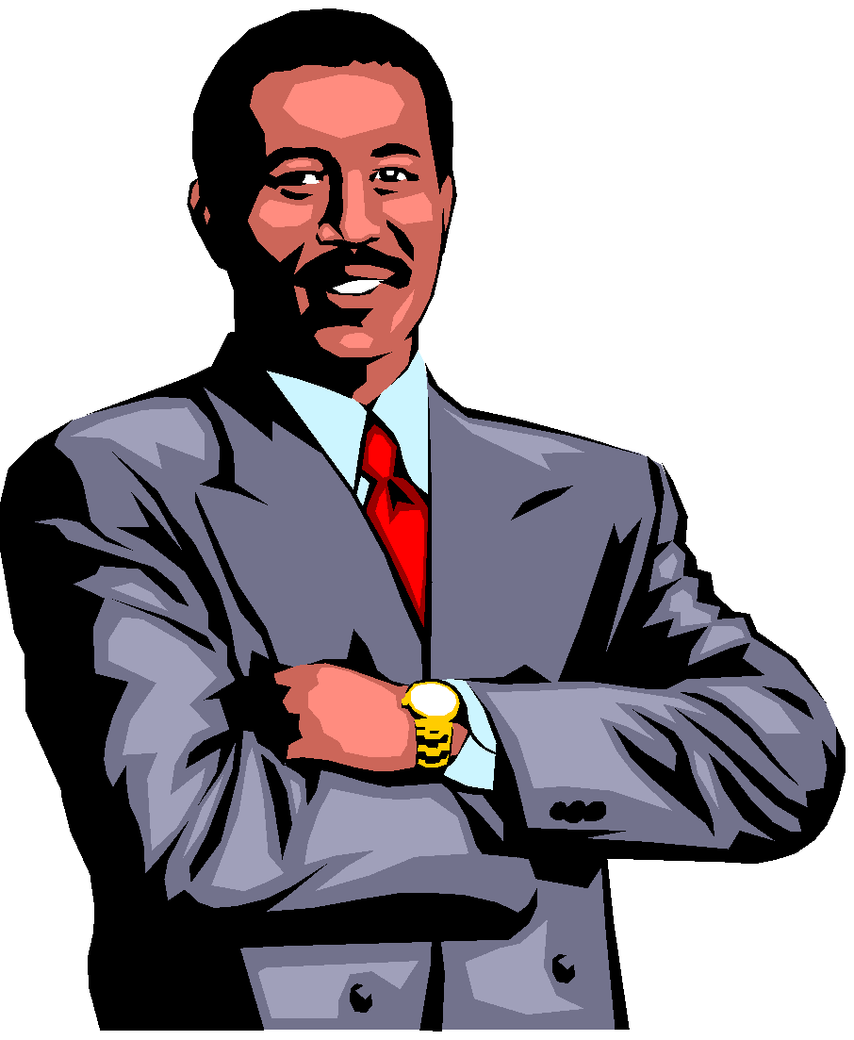
Project the Company’s Image
Be a spokesperson
Convey the right impression
Minimize your own views
Maximize company interests

